Slide 1

Renewable power plant

Slide 2
The problem
Renewable hybrid solar/wind energy powerplant
Constant demand of 6MW
Lowest possible cost
Simulink simulation
Notes:
We need to find the find the best configuration for a hybrid solar/wind energy powerplant to power danone factory that has a constant demand of 6MW. This configuration must be the lowest cost or close to the lowest cost configuration for a specific scenario. We also need to use the Simulink simulation that will provide us with the the power output based on the weather data and the configuration that is given.

Slide 3
Our solution
Call simulink simulation from python
Calculate the cost of the setup
Minimize the cost with a genetic algorithm

Slide 4
Genetic algorithm
Start with pool of random 100 configurations
Run simulations and calculate costs
Keep ones with lowest cost
Make new pool setups based on these ones
Add random mutations
Repeat

Slide 5
Cost calculation – Fitness Function
Solar panels
Windturbines
Required storage
Power cable
Artifically increase cost when not producing at least 6 MW

Slide 6
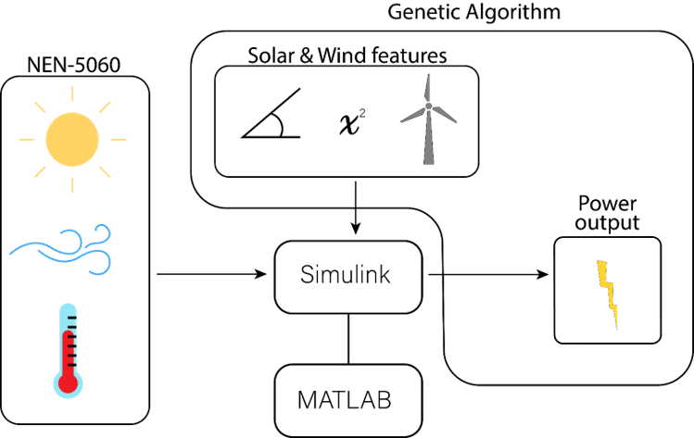
Current simulation
Notes:
We made an genetic algorithm that will find the best configuration for a hybrid solar/wind energy powerplant. Our genetic algorithm makes a pool of 100 configuration of random solar and wind features.
These parameters get send along with the data to the Simulink simulation that will returns the power output that is a list of energy that is produced every hour. We calculate the cost of the configuration and select the best configurations and let them randomly exchange parameters with eachother and run a new set of configurations. This process you repeat mutiple times until you are satified with the results.

Slide 7
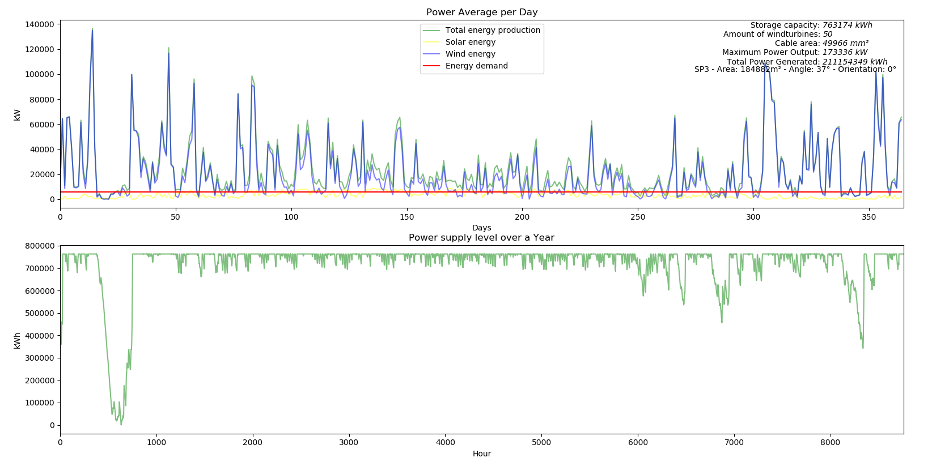
Hybrid/Solar configuration
Notes:
This figure shows what the best parameters could be for the cheapest configuration and the distribution of energy over the year.

Slide 8
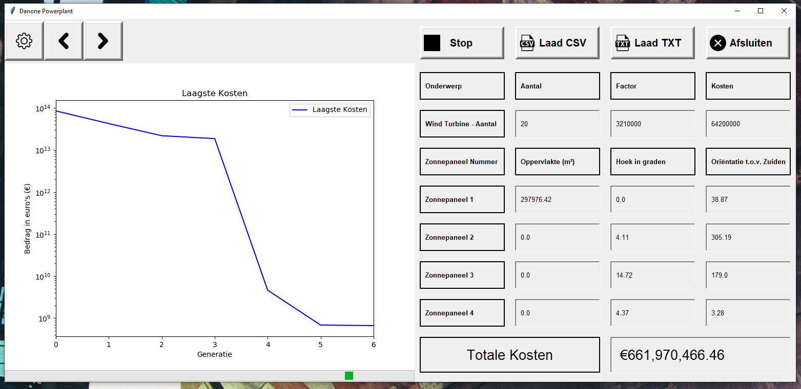
Graphical User Interface
Notes:
This is the Graphical interface of our application. We can change mutiple parameters of the simulation and it provides us with information what the best configuration is of the last generation and a graph that can show us the training process but also how much energy is produced over the year for that specific configuration. We will after this presentation show you the interface in realtime after this presentation.

Slide 9
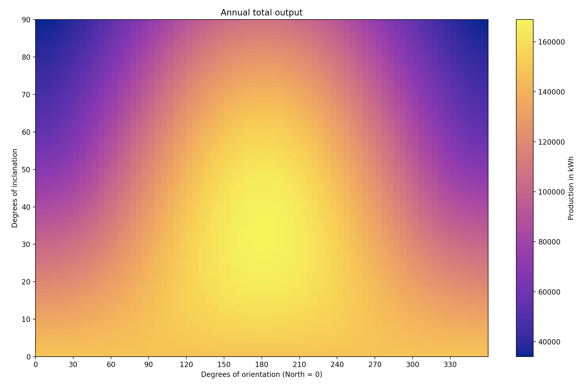
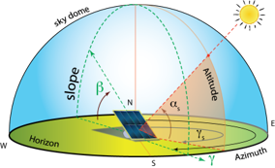
The energy that is produced for each orientation and angle
Notes:
The amount of energy that is produced by the simulation for each orientation and angle of the PV-panels.
When you focus on this figure you can see that PV-panels with an orientation to the south and an angle of 37 degrees produces the most power

Slide 10
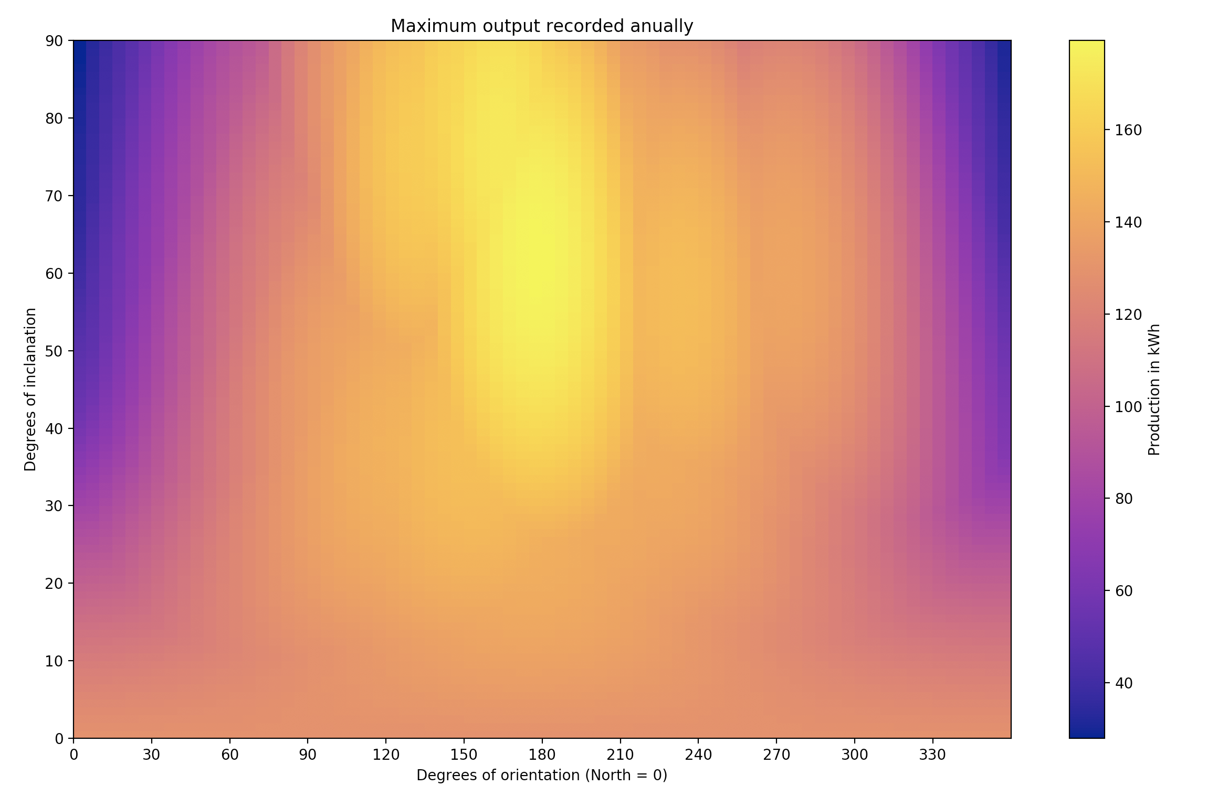

Maximum power production for each angle and orientation
Notes:
The maximum power that has been produceerd in a specific hour for each orientation and angle of the PV-panels

Slide 11
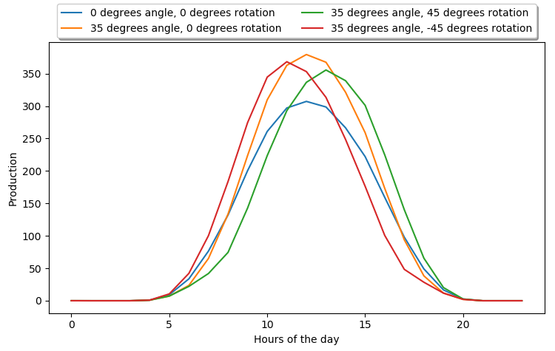
Solarpanel production with different angles and orientation
Notes:
In this graph we can see the four different configuration for solar panels. I would first like to focus on the orange and blue configurations.
The blue one represent a configuration that has its solar panels laying down flat on the ground and the yellow graph is a configuration with its solar panels 35 degrees up from the ground towards the south.
As probably some of you are noticing that the more flat solar panels produce more in the morning and less midday compared to the solar panels with a angle of 35 degrees.
We believe when the storage cost of elektricity is unrealistically high the best configuration would be solar panels with an angle of 0 degrees because it needs less batteries to pass over the night but we are not entirely sure.
The red and green one show solar panels that are slightly faced towards the east and west. This means that the solar panels in the east produce more energy in the morning and the ones in the west produce more energy in the evening.

Slide 12
Future Ideas
Use expanded KNMI weather data
31 Locations with 20 years of data
Look for paterns in geographical location
Running the simulation in Python
Around 80 times faster (80000%)
4 Hours in ~3 minutes
5 Days in ~1,5 hours
KNMI Weather data
Python

Slide 13
Questions

